Slide 1
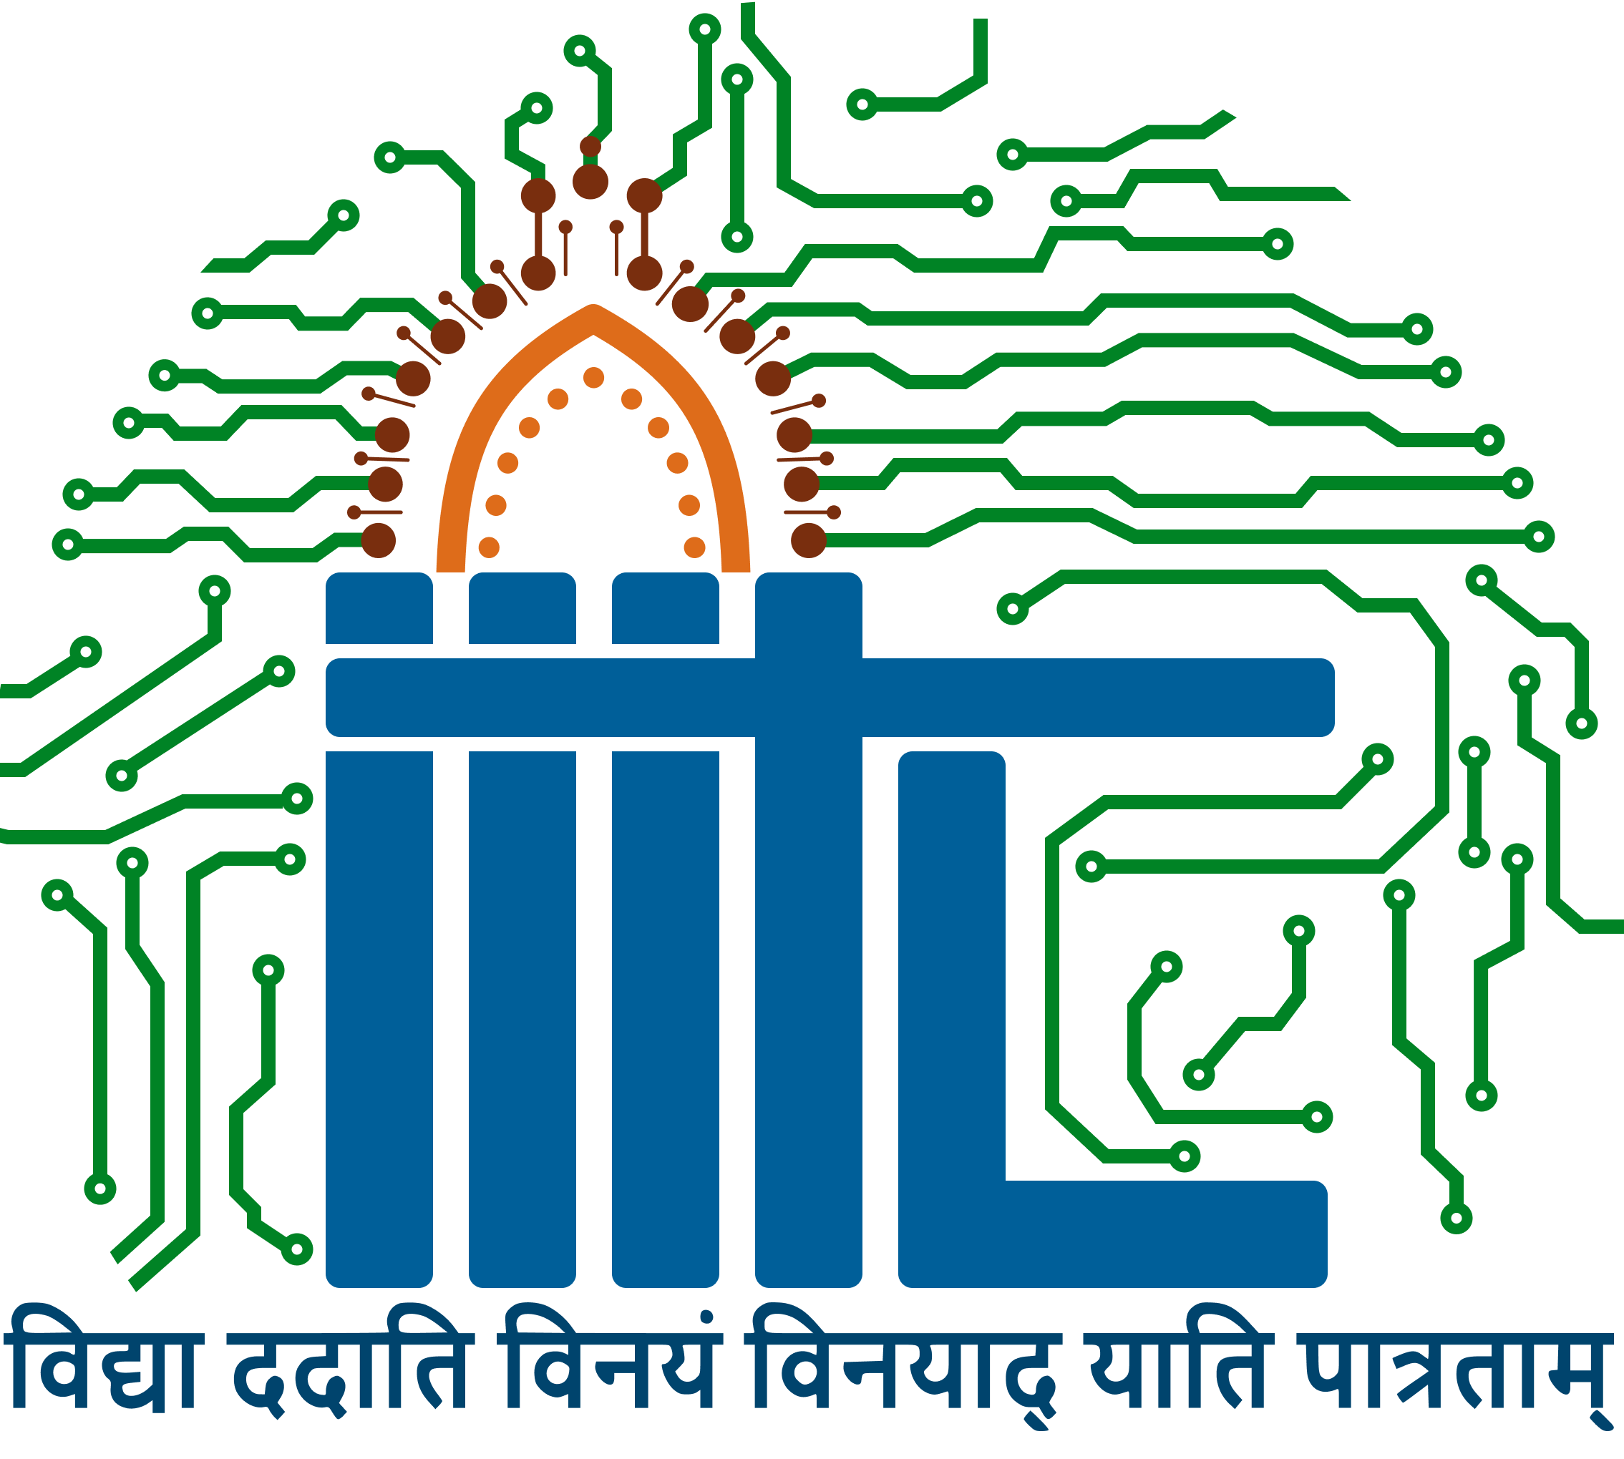
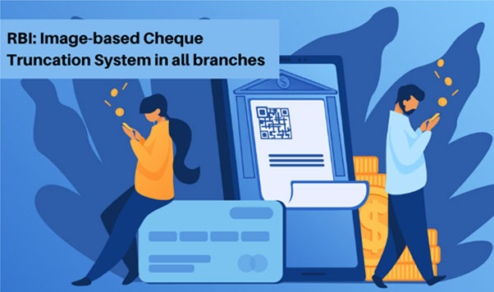
Digital Cheques Leveraging Blockchain Technology
Indian Institute of Information Technology, Lucknow
Submitted to: Professor Vinaya Satyanarayana
Date: 12-12-24
Group Number: 04

Slide 2


Team Members:
Harsh Golchha- LCI 2021002
Narendula Gresshma- LCB 2021018
Aditya Kumar- MDB23012
Rohit Dixit-MDB23014
Abhijit Prasad- MDB23015

Slide 3
Area of Focus
Objective: This project focuses on transforming the traditional cheque system by integrating blockchain technology. It addresses core issues such as time delays, security vulnerabilities, and inefficiencies, creating a modernized approach to cheque-based transactions.
Abstract : The cheque system is still widely used in various countries, but its reliance on physical documentation and centralized verification makes it prone to fraud, delays, and loss. Blockchain provides an opportunity to digitize this process, making it faster, more secure, and user-friendly.

Slide 4

Idea Description
The proposed solution, Blockchain-Based Digital Cheque System, leverages the features of blockchain—such as decentralization, immutability, and cryptographic security—to create a streamlined and robust system for cheque transactions.

Slide 5
Key Features:
Time Efficiency
Enhanced Security
Smart Contracts
Traceability
Ease of Use

Slide 6
Value Chain:
Time delays (2–5 days for clearance).
Risk of forgery, theft, or loss.
Manual processes introduce errors and inefficiencies.

Slide 7
Steps in Traditional Cheque Clearing Process
Issuer writes a cheque and provides it to the recipient.
Recipient deposits the cheque at their bank.
The cheque is sent to a clearinghouse for validation.
Clearinghouse coordinates with the issuing bank for fund release
Funds are transferred to the recipient’s account.

Slide 8
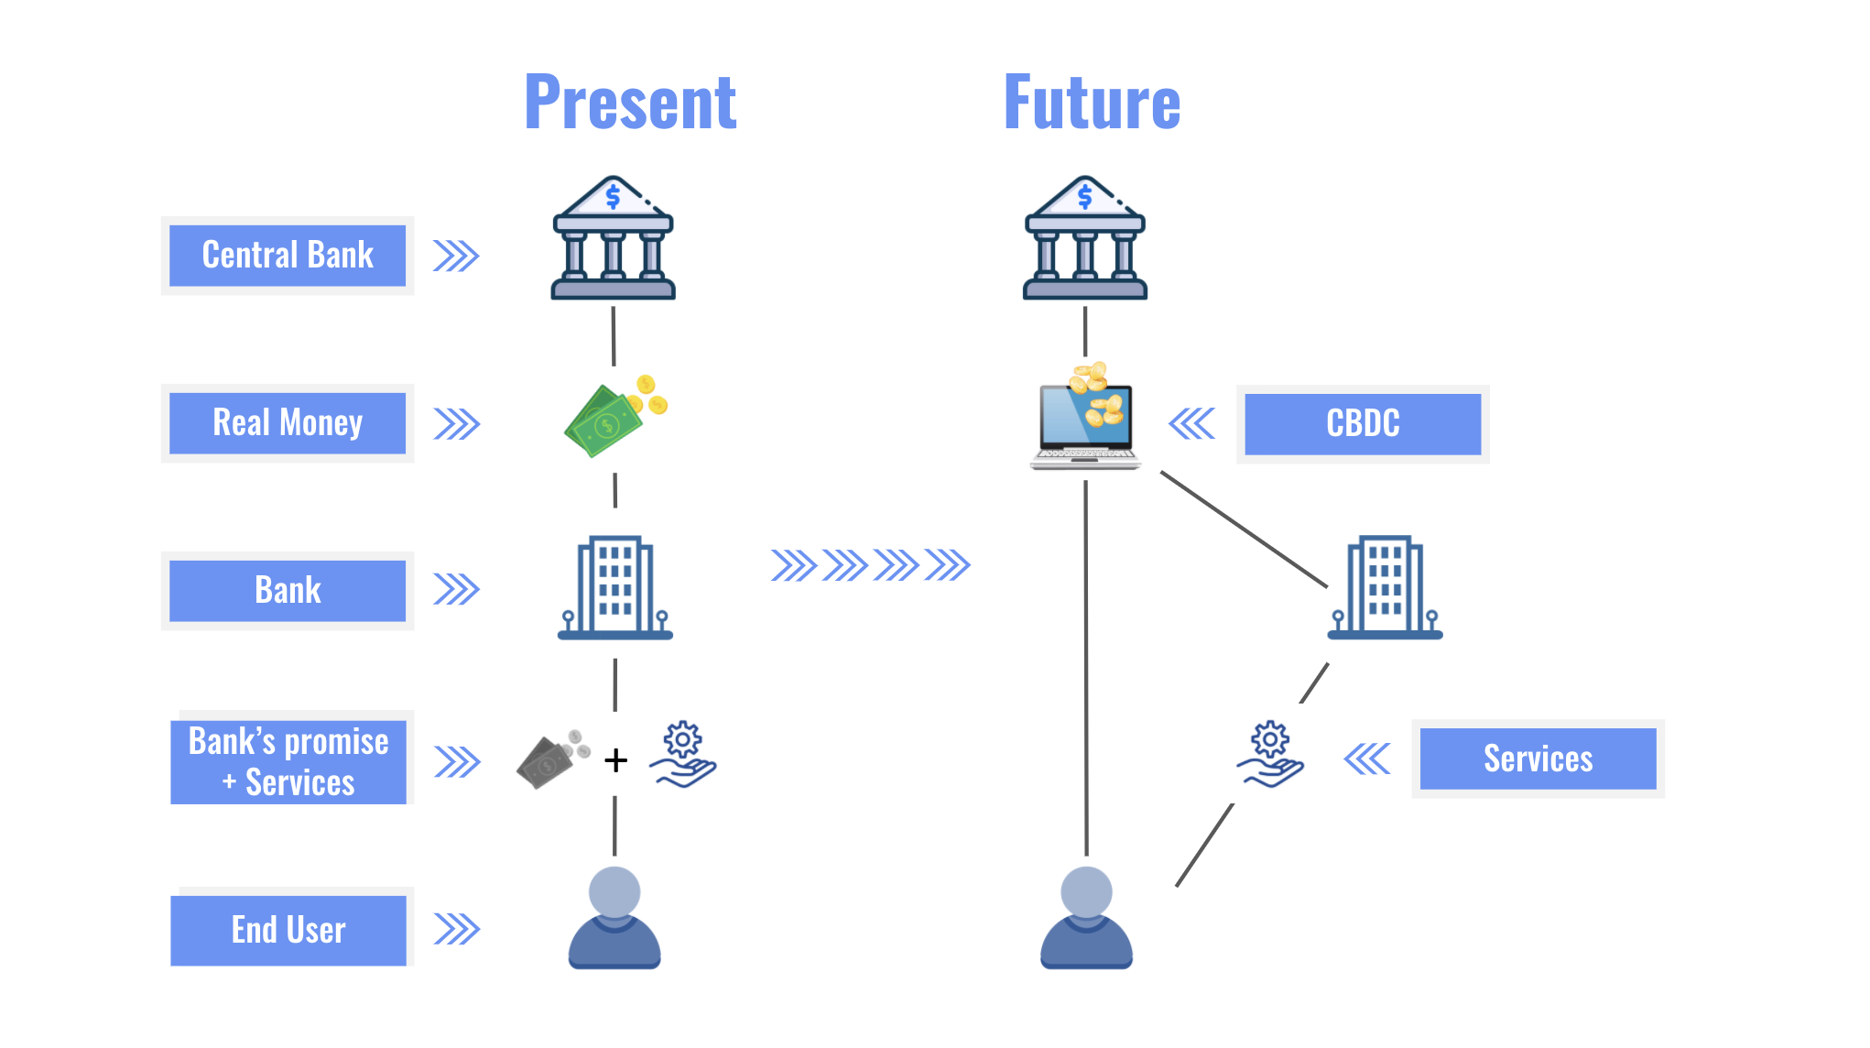
Blockchain Startup’s Role
Our system replaces the clearinghouse and manual verification process with a decentralized ledger that instantly verifies and records transactions. This ensures faster processing, increased security, and reduced operational costs for banks.

Slide 9
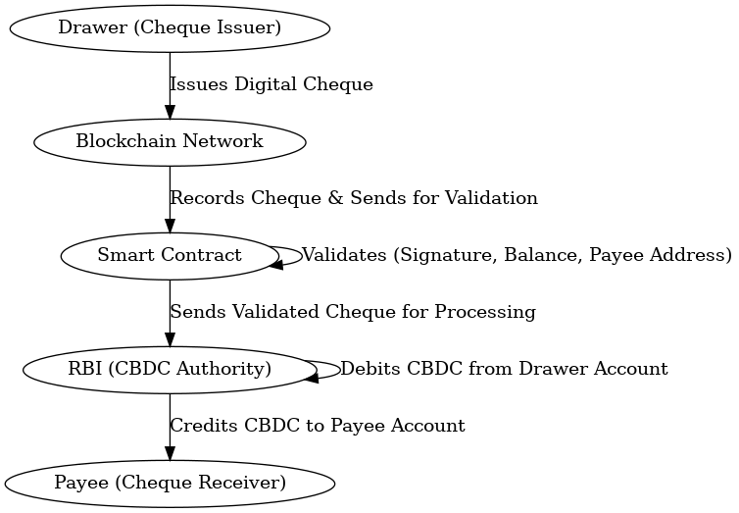
Design

Slide 10


Regulatory Authorities
Reserve Bank of India (RBI): RBI governs digital payment systems and financial instruments, ensuring security and compliance. Guidelines on Payment and Settlement Systems Act, 2007.
Ministry of Electronics and Information Technology (MeitY): Provides the framework for secure digital transactions and personal data protection under the Digital India initiative.

Slide 11
Regulations Supporting the Startup:
RBI’s support for digital banking innovations under its Payment Vision 2025 roadmap.
MeitY’s emphasis on promoting blockchain for governance and financial applications.

Slide 12
Technology
Blockchain Framework
Smart Contracts
APIs
Cryptographic Keys

Slide 13
Solution Architecture
Frontend: Web and mobile app for user interactions.
Middleware: API gateway for secure communication between the app and blockchain.
Backend: Blockchain ledger and smart contract system for transaction processing.

Slide 14
Customer and User Behavior
Target Users:
Individual Users
Small Businesses
Large Enterprises
Value Proposition:
Time Savings
Security
Convenience
Pays for the Service
Primary Payers
Secondary Payers

Slide 15


Market and Strategic Analysis
The financial services market is teeming with established digital payment providers like Paytm, Razorpay, and other global platforms such as Google Pay and PhonePe. These competitors have significantly influenced consumer behavior and raised the standard for digital payment solutions, offering seamless transactions, low costs, and user-friendly interfaces.

Slide 16
Porter’s Five Forces Analysis
Threat of New Entrants – Low
Bargaining Power of Buyers – High
Bargaining Power of Suppliers – Moderate
Threat of Substitutes – Moderate to High
Industry Rivalry – Moderate

Slide 17
SWOT Analysis
Strengths
Enhanced Security
Efficiency
Scalability
Weaknesses
High Initial Development Costs
Learning Curve
Opportunities
Rising Digital Adoption
Expansion Potential
Threats
Regulatory Challenges
Competing Payment Systems

Slide 18
Funding
Funding Requirements:
$500,000 for development, testing, and initial deployment.
Launch Timeline:
Prototype: 6 months.
Pilot Testing: 9 months.
Full Launch: 12 months.
Potential Partners:
Banks for system integration.
Fintech startups for app development and testing.
Initial Customers:
Businesses in the e-commerce and retail sector requiring fast payment settlements.

Slide 19
Conclusion
The Blockchain-Based Digital Cheque System revolutionizes cheque transactions with enhanced security, real-time processing, and programmability, offering an efficient and compliant alternative to traditional methods. By aligning with India's digital transformation goals like RBI Payment Vision 2025, it addresses past inefficiencies, ensuring a seamless, secure, and user-friendly payment experience for individuals, businesses, and corporate entities across demographics.

Slide 20
THANK YOU
Any Question?

